Slide 1
The Structure of the Prokaryote Cell
Small size ( 0.5 to 2um)
Large surface area to volume ratio
A variety of shapes
Outer cell wall- very thick made of specialized molecules
Cell membranes may have a different constituency of molecules from eukaryote cells
Ribosomes smaller(70s type)
No organelles, no nuclear membrane
1 ds circular loop of DNA called Genophore

Slide 2
The Structure of the Prokaryote Cell
Prokaryotic cells almost always are bounded by a chemically complex cell wall.
Inside this wall, and separated from it by a periplasmic space, lies the plasma membrane.
The genetic material is localized in a discrete region, the nucleoid, and is not separated from the surrounding cytoplasm by membranes.
Ribosomes and larger masses called inclusion bodies are scattered about in the cytoplasmic matrix
Both gram-positive and gram-negative cells can use flagella for locomotion.
In addition, many cells are surrounded by a capsule or slime layer external to the cell wall.

Slide 3
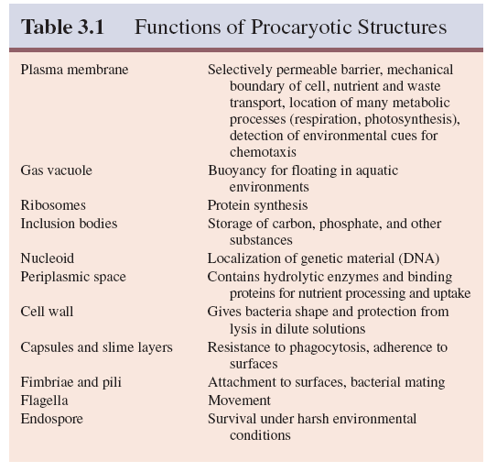

Slide 4
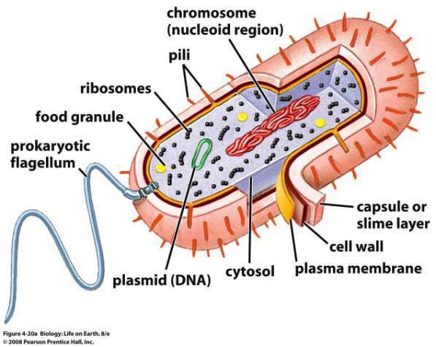

Slide 5
Cell wall
The cell wall is the layer, usually fairly rigid, that lies just outside the plasma membrane.
Give them shape and protect them from osmosis;
The cell walls of many pathogens have components that contribute to their pathogenicity.
The wall can protect a cell from toxic substances and is the site of action of several antibiotics.
Peptidoglycan-the most important molecule in the cell walls of bacteria

Slide 6
Cell wall
The gram-positive cell wall consists of a single 20 to 80 nm thick homogeneous
peptidoglycan or murein layer lying outside the plasma membrane
the gram-negative cell wall is quite complex. It has a 2 to 7 nm peptidoglycan layer
surrounded by a 7 to 8 nm thick outer membrane.

Slide 7
Cell wall
Peptidoglycan or murein is an enormous polymer composed of many identical subunits. The polymer contains two sugar derivatives, N-acetylglucosamine and N-acetylmuramic acid (the lactyl ether of N-acetylglucosamine)
several different amino acids, three of which—D-glutamic acid, D-alanine, and meso-diaminopimelic acid

Slide 8
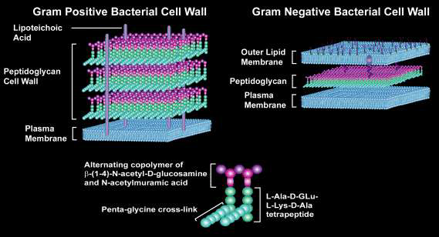

Slide 9
Gram +ve cell wall
Homogeneous cell wall of gram-positive bacteria is composed primarily of peptidoglycan, which often contains a peptide interbridge
The teichoic acids are connected to either the peptidoglycan by a covalent bond with Nacetylmuramic acid or to plasma membrane lipids are called lipoteichoic acids.

Slide 10
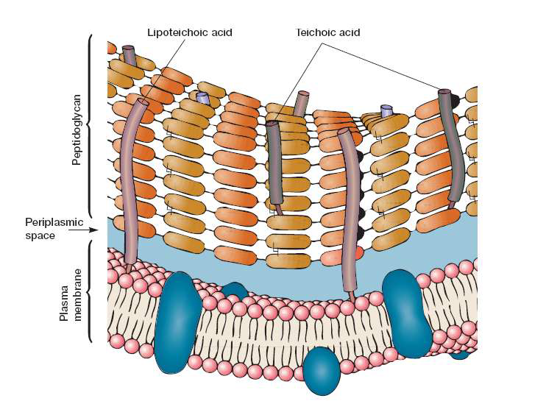

Slide 11
Gram –ve cell wall
The outer membrane lies outside the thin peptidoglycan layer
The most abundant membrane protein is Braun’s lipoprotein, covalently joined to the underlying peptidoglycan and embedded in the outer membrane by its hydrophobic end.
constituents of the outer membrane are its lipopolysaccharides
outer membrane is more permeable than the plasma membrane due to the presence of special porin proteins

Slide 12
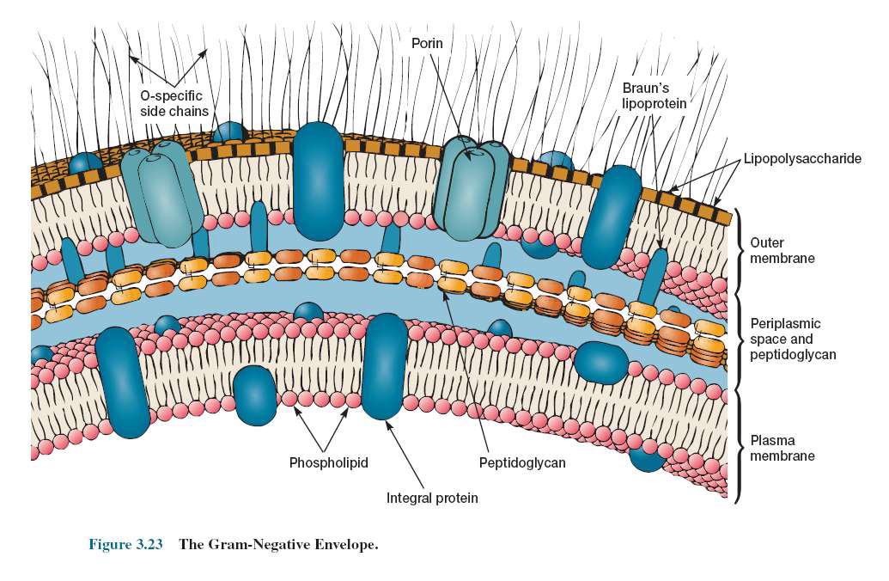

Slide 13
Capsules, Slime Layers, and S-Layers
Some bacteria have a layer of material lying outside the cell wall. When the layer is well organized and not easily washed off, it is called a capsule.
A slime layer is a zone of diffuse, unorganized material that is removed easily
Many gram-positive and gram-negative bacteria have a regularly structured layer called an S-layer on their surface
The S- layer has a pattern something like floor tiles and is composed of protein or glycoprotein
In gram-negative bacteria the S-layer adheres directly to the outer membrane; it is associated with the peptidoglycan surface in gram-positive bacteria.
It may protect the cell against ion and pH fluctuations, osmotic stress, enzymes, or the predacious bacterium Bdellovibrio.
The S-layer also helps maintain the shape and envelope rigidity of at least some bacterial cells. It can promote cell adhesion to surfaces.

Slide 14
Pili and Fimbriae
Many gram-negative bacteria have short, fine, hair like appendages that are thinner than flagella and not involved in motility. These are usually called fimbriae
Pilus are similar appendages, about 1 to 10 per cell, that differ from fimbriae in the following ways.
Pili often are larger than fimbriae (around 9 to 10 nm in diameter).
They are genetically determined by sex factors or conjugative
Plasmids and are required for bacterial mating.
Some bacterial viruses attach specifically to receptors on sex pili at the start of their reproductive cycle.

Slide 15
Flagella and Motility
Motile bacteria move by use of flagella Threadlike locomotor appendages extending outward from the plasma membrane and cell wall.
They are slender, rigid structures,about 20 nm across and up to 15 or 20 m long

Slide 16
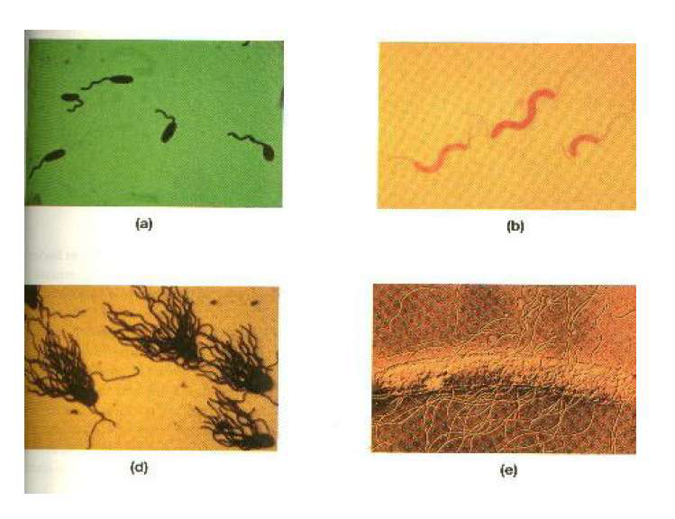
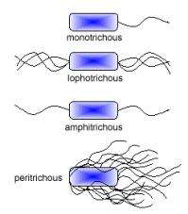

Slide 17
Flagella and Motility
Flagella is a hair like structure.
Flagellar filaments are made of subunits of a single protein-flagellin.
The transmission electron microscope studies have shown that flagellum is composed of three parts.
Filament-extend from cell surface to the tip.
Basal body-embeded in the cell.

Slide 18
Flagella and Motility
Filament is a hollow rigid cylinder made of flagellin.
Hook is curved portion, slightly wider than filament.
Basal body is the most complex part of a flagellum.
It differs in Gram positive and Gram negative bacteria.

Slide 19
Flagella and Motility
The basal body of gram negative bacteria has four rings connected to a central rod.
A pair of ring embedded in cell membrane(M ring and S ring) and another pair associated with the cell wall(L ring and P ring).
The outer L and P rings associated with lipopolysaccharide and peptidoglycan respectively.
Inner M ring-plasma membrane and S ringnear periplasmic space

Slide 20
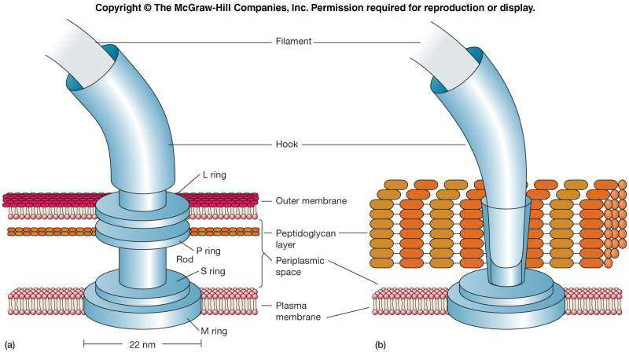

Slide 21
Flagella and Motility
The Gram positive bacteria have only two rings in their basal body.
The inner M ring-connected to plasma membrane.
The outer S ring-attached to peptidoglycan.
Since Gram positive bacteria lack the outer pair of rings, it is assumed that only the inner rings are essential for flagellar motion.

Slide 22
The Bacterial Endospore
A number of gram-positive bacteria can form a special resistant, dormant structure called an endospore.
Endospores develop within vegetative bacterial cells of several genera: Bacillus and Clostridium (rods), Sporosarcina (cocci), and others.
Spore formation, sporogenesis or sporulation, normally commences when growth ceases due to lack of nutrients.

Slide 23
The Plasma Membrane
Membranes contain both proteins and lipids
Bacterial plasma membranes usually have a higher proportion of protein than do eukaryotic membranes
lipids form a bilayer in membranes
Bacterial membranes lack sterols such as cholesterol
Cell membranes are very thin structures, about 5 to 10 nm thick

Slide 24
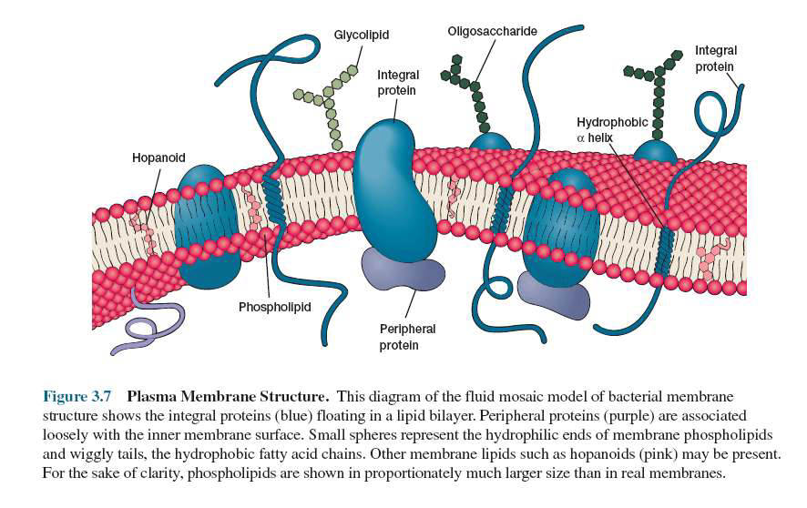

Slide 25
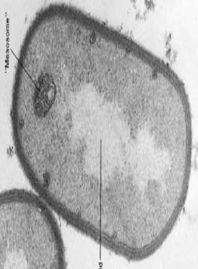
Internal Membrane Systems
Does not contain complex membranous organelles like mitochondria or chloroplasts
Mesosomes are invaginations of the plasma membrane in the shape of vesicles, tubules, or lamellae
Thus they may be involved in cell wall formation during division or play a role in chromosome replication and distribution to daughter cells.

Slide 26
Inclusion Bodies
A variety of inclusion bodies, granules of organic or inorganic material are present in the cytoplasmic matrix Used for storage (e.g., carbon compounds, inorganic substances, and energy), and also reduce osmotic pressure by tying up molecules in particulate form. For example, polyphosphate granules, cyanophycian granules, and some glycogen granules.
Examples of membrane-enclosed(single layer) inclusion bodies are poly--hydroxybutyrate granules, some glycogen and sulfur granules, carboxysomes, and gas vacuoles.

Slide 27
Inclusion Bodies
Cyanophycin granules (present in many cyanobacteria) are composed of large polypeptides containing approximately equal amounts of the amino acids arginine and aspartic acid.
The granules store extra nitrogen for the bacteria.
Carboxysomes are present in many cyanobacteria, nitrifying bacteria, and thiobacilli.
They are polyhedral, about 100 nm in diameter, and contain the enzyme ribulose- 1,5-bisphosphate carboxylase in a paracrystalline arrangement.
They serve as a reserve of this enzyme and may be a site of CO2 fixation.

Slide 28
Inclusion Bodies
Gas vacuole -organic inclusion body present in many cyanobacteria , purple and green photosynthetic bacteria, and a few other aquatic forms such as Halobacterium and Thiothrix. Gas vacuoles give them buoyancy.
Gas vacuoles are aggregates of enormous numbers of small, hollow, cylindrical structures called gas vesicles.
Gas vesicle walls are composed entirely of a single small protein.
These protein subunits assemble to form a rigid enclosed cylinder that is hollow an impermeable to water but freely permeable to atmospheric gases.

Slide 29
Inclusion Bodies
Polyphosphate granules or volutin granules volutin granules function as storage reservoirs for phosphate, an important component of cell constituents such as nucleic acids.
In some cells they act as an energy reserve, and polyphosphate can serve as an energy source in reactions.
These granules are sometimes called metachromatic granules
Magnetosome is used by some bacteria to orient in the earth’s magnetic field. These inclusion bodies contain iron in the form of magnetite

Slide 30
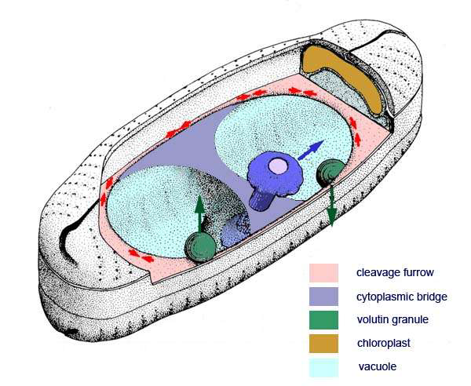
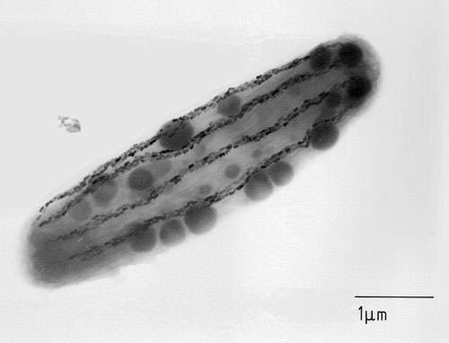
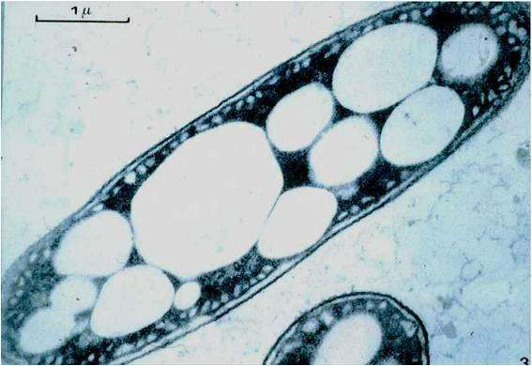
MAGNOTACTIC BACTERIA
Gas vacoules

Slide 31
Ribosomes
Ribosomes loosely attached to the plasma membrane. (70S ribosomes) Made of both protein and ribonucleic acid (RNA).
They are the site of protein synthesis;
Matrix ribosomes synthesize proteins destined to remain within the cell,
Plasma membrane ribosomes make proteins for transport to the outside.

Slide 32
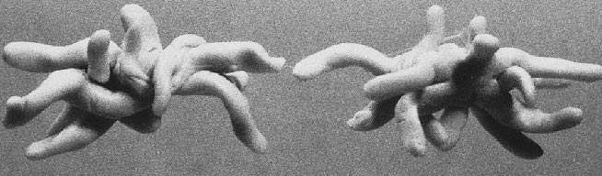
Nucleoid
Prokaryotic chromosome is located in an irregularly shaped region called the nucleoid
composed of about 60% DNA, 30% RNA, and 10% protein by weight
prokaryotes contain a single circle of double stranded
deoxyribonucleic acid (DNA), but some have a linear DNA chromosome.

Slide 33
EXTRA CHROMOSOMAL GENETIC MATERIAL
Many bacteria possess plasmids in addition to their chromosome.
These are double-stranded DNA molecules, usually circular, that can exist and replicate independently of the chromosome or may be integrated with it(epoisomes) In both case they normally are inherited or passed on to the progeny.
Plasmid genes can render bacteria drug-resistant, give them new metabolic abilities, make them pathogenic, or endow them with a number of other properties.

Slide 34
THANK YOU

